Slide 1
OFFICE365 – Assignment 5
Discussion 5 – Create a PowerPoint presentation (at least three slides, and share (attach to your discussion post response) your slides with the class. What did you learn?

Slide 2
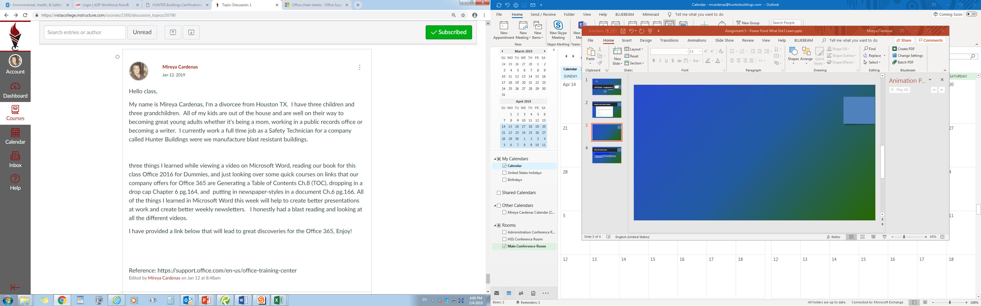

Slide 3
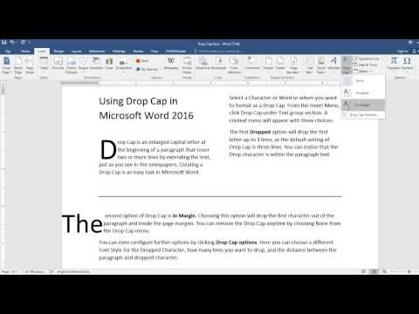

2 Out of 3 Valuable Things I learned in Office 365
1st Thing I Learned
2nd Thing I Learned
Dropping in a drop cap
Generating a Table of Contents TOC

Slide 4
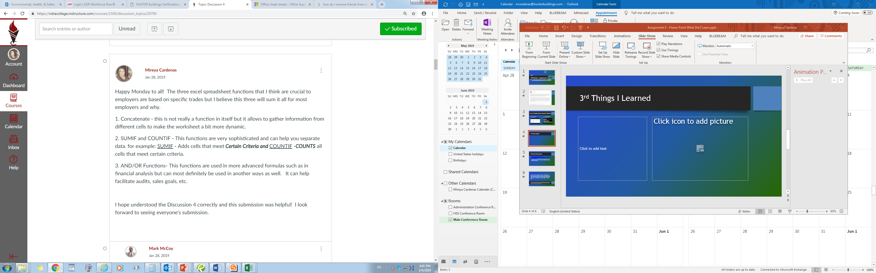
3rd Things I Learned

Slide 5
Office 365 Training Center
https://support.office.com/office-training-center?redirectSourcePath=%252farticle%252fb8f02f81-ec85-4493-a39b-4c48e6bc4bfb
I like using the link above because it has everything you need to know about Office365. It also has training templates, quick starts learning basics and tips.

Slide 6
Overall I have enjoyed this class tremendously. I have learned a lot of new things, some short cuts, some new things that have come up recently and some things I just didn’t’ know existed in office 365.
Looks like our shift here has ended but has it really? I believe our shift here has just begun. We never stop learning and with every new thing we’ve learned we become more valuable to our employers. Saying you know something and putting on paper (resume) isn’t good anymore. You have to bring what you know to the table, you have to prove yourself.

